Slide 1
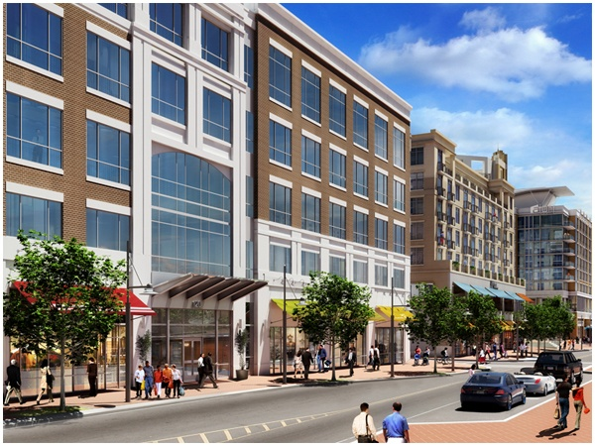
NATIONAL HARBOR BUILDING M
120 Waterfront St. Oxon Hill, Maryland
Ryan Sarazen – Structural Option
Senior Thesis Presentation – Spring 2008
Faculty Consultant – Dr. Lepage

Slide 2
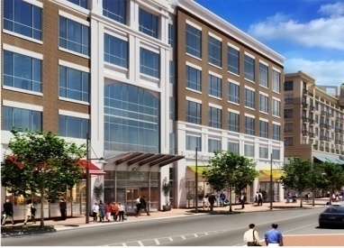
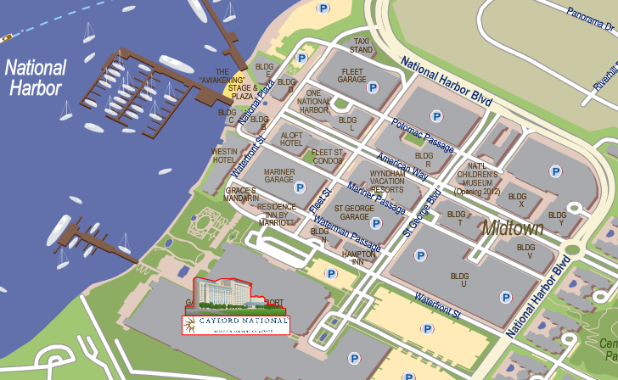
BUILDING LOCATION
BUILDING M
SITE PLAN FROM WWW.NATIONALHARBOR.COM

Slide 3
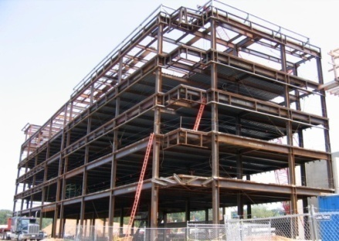
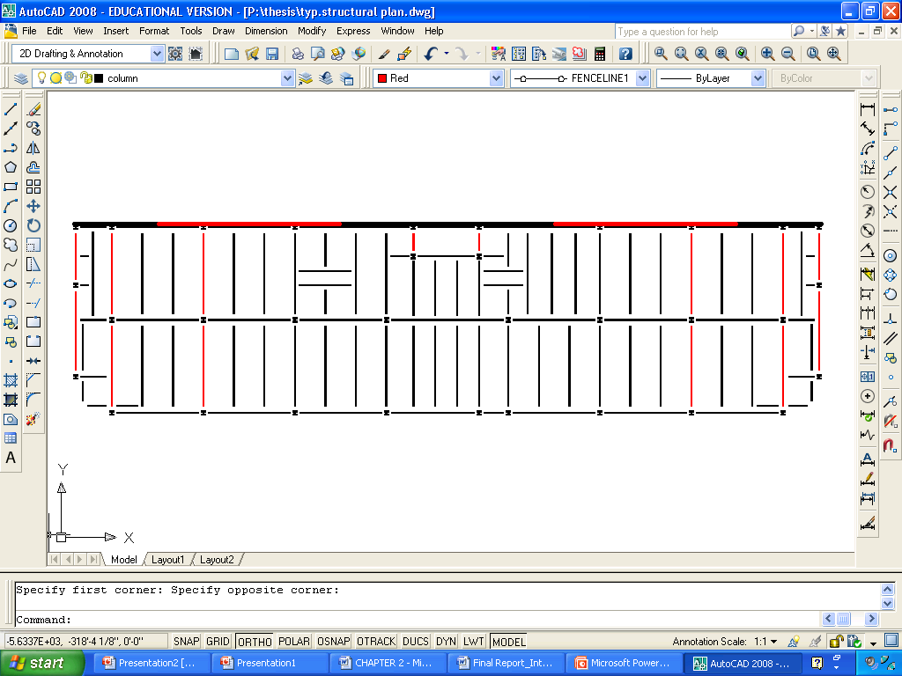
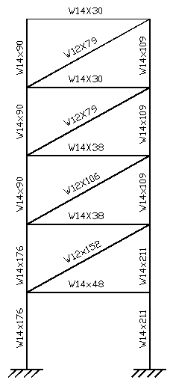
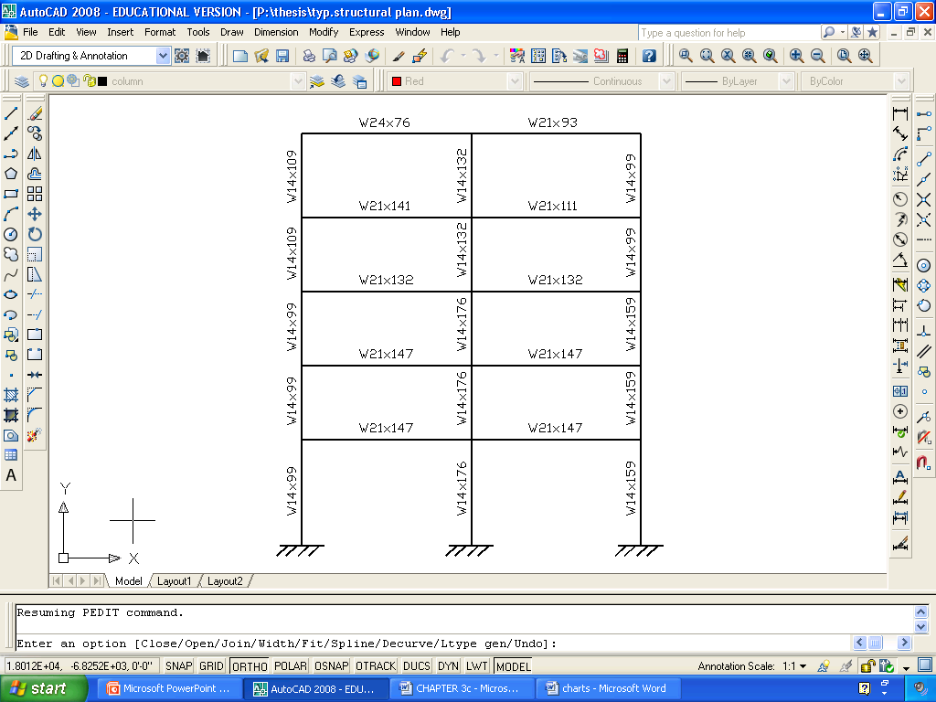
EXISTING BUILDING DATA
General Data:
  Size: 81,801 SF (14,688 Retail, 67,133 Office)
  Height: 5 stories – 73’-4” tall
  Cost: 9.5 Million Dollars
Structural:
  6-1/4” LWC composite slab
  Steel Braced and Moment Frame,
  and Masonry Shear Wall Lateral systems
  14” sq. precast prestressed concrete piles
  4” expansion joint running length of building
  separating adjacent parking structure

Slide 4
THESIS OBJECTIVES- INTRODUCTION
STRUCTURAL DEPTH - achieve efficiency of the steel design using a concrete-based structure
ARCHITECTURAL FAÇADE - determine and design the most STUDY BREADTH efficient wall system for the rear façade
CONSTRUCTION INVESTIGATION- determine effects of the concrete BREADTH redesign in terms of cost, schedule, and site layout

Slide 5
STRUCTURAL DEPTH -
Post-Tension Concrete Redesign

Slide 6
STRUCTURAL DEPTH- GOALS
FLOOR SYSTEM- design concrete floor system capable of spanning 30’ bays without excessive structural depth
COLUMN GRID- attempt to maintain existing column grid
LATERAL SYSTEM- replace steel moment/braced frames and CMU shear walls with concrete lateral elements
FOUNDATION SYSTEM- modify existing system to support concrete system

Slide 7
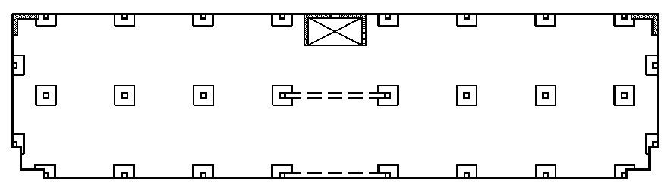
STRUCTURAL DEPTH- PT FLOOR SYSTEM
30’-0” x 30’- 5 ½” typical bay
8” thick slab
f’c = 5,000 psi
0.6” diameter unbonded tendons
7.5’x7.5’x4” Column Caps for shear reinforcement
Concrete Beams at 40’ span location

Slide 8
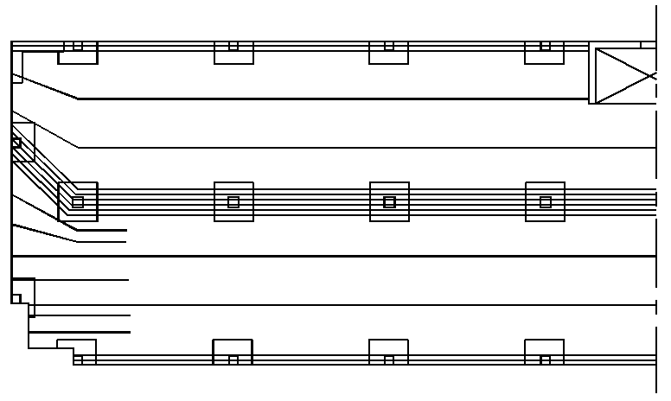
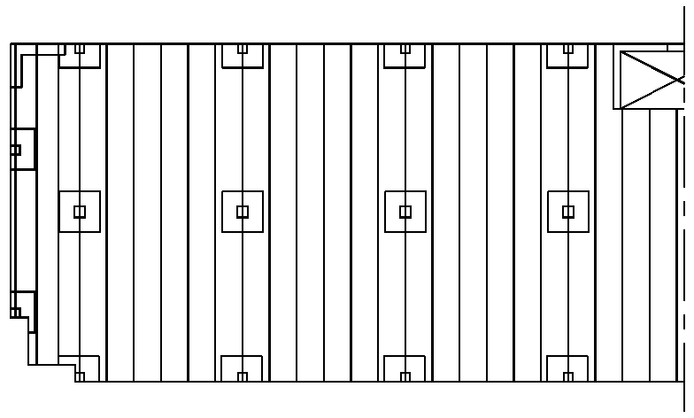
STRUCTURAL DEPTH- PT FLOOR SYSTEM
TYPICAL TENDON LAYOUTS:
BANDED DISTRIBUTED

Slide 9
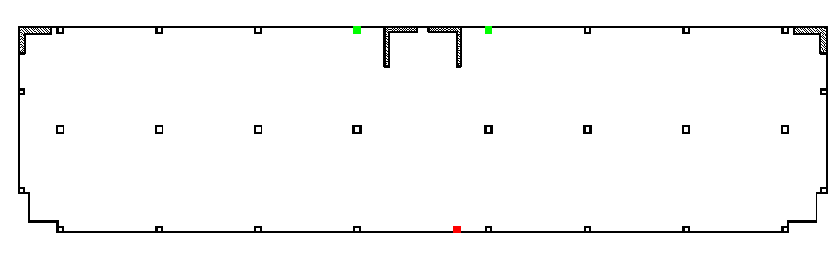
STRUCTURAL DEPTH- COLUMN DESIGN
Attempted to maintain existing column grid which provides open floor plan that is beneficial to office/ retail buildings
Minor changes: Red Column Removed, Green Columns Added

Slide 10
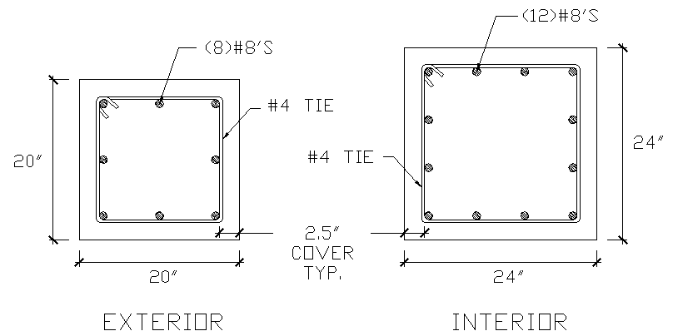
STRUCTURAL DEPTH- COLUMN DESIGN
Columns broken into 2 groups (Exterior and Interior) and designed for the worst case loads of each group.

Slide 11
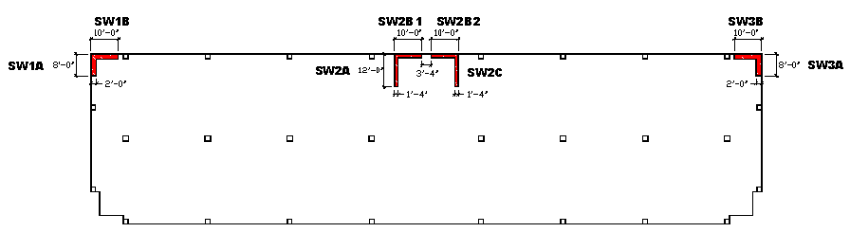
STRUCTURAL DEPTH- LATERAL SYSTEM
REINFORCED CONCRETE SHEAR WALLS

Slide 12
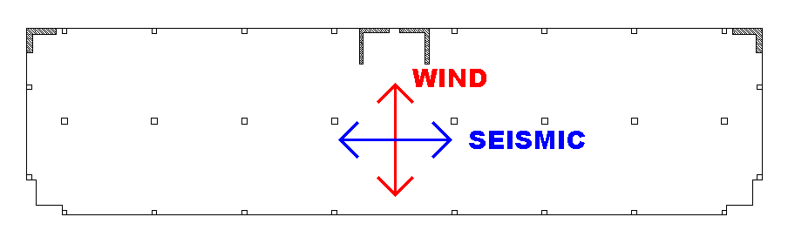
STRUCTURAL DEPTH- LATERAL SYSTEM
CONTROLLING LOADS
Item | Longitudinal (N-S) | Transverse (E-W)
1.6 Wind | 141 K | 730 K
1.0 Seismic | 369 K | 369 K

Slide 13
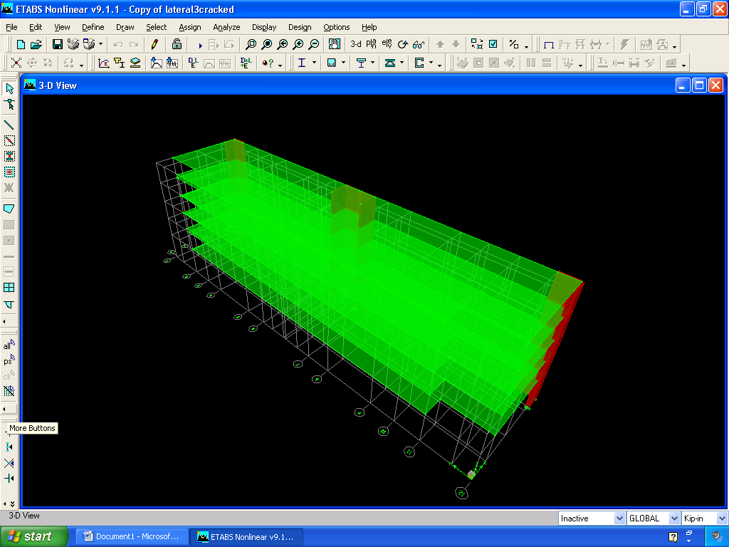
STRUCTURAL DEPTH- LATERAL SYSTEM
ETABS MODEL CREATED FOR LATERAL ANAYLYSIS
  Modal Analysis Run to Determine Building Period
  Model Used to Distribute Lateral Loads Based on Relative Stiffness
Mode | Period T (seconds)
1 | 1.7340
2 | 1.0149
3 | 0.6678
Member | Trans. Load (K) | % of Trans Load | Long. Load (K) | % of Long. Load
SW 1A/1B | 77.3 | 19.15% | 88.8 | 22.39%
SW 2A1/2B1 | 124.5 | 30.85% | 96.0 | 24.21%
SW 2A2/2B2 | 124.5 | 30.85% | 96.0 | 24.21%
SW 3A/3B | 77.3 | 19.15% | 88.8 | 22.39%

Slide 14
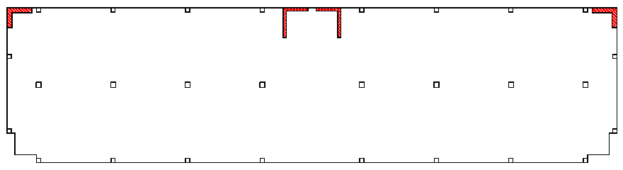
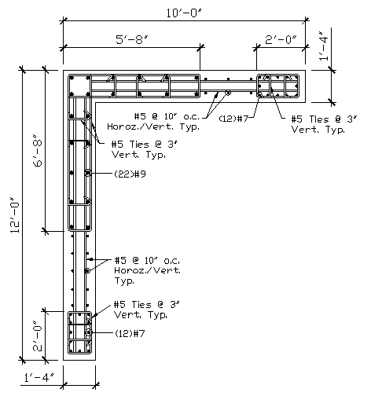
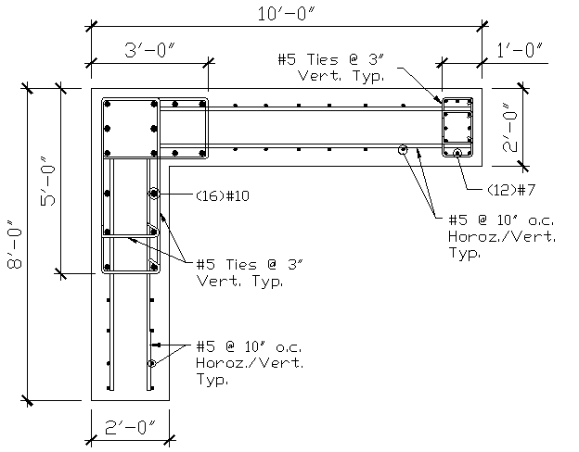
STRUCTURAL DEPTH- LATERAL SYSTEM
TYPICAL SHEAR WALL REINFORCING DESIGNS
SHEAR WALL 1/3
SHEAR WALL 2

Slide 15
STRUCTURAL DEPTH- LATERAL SYSTEM
STRUCTURE DRIFT AND DISPLACEMENT LIMITS
  TRANSVERSE DIRECTION – 1.6 WIND
  LONGITUDINAL DIRECTION – 1.0 SEISMIC

Slide 16
STRUCTURAL DEPTH- FOUNDATION
FOUNDATION SYSTEM CONSISTS OF 14” SQ. PRECAST PRESTRESSED CONCRETE PILES
LOAD ACCUMULATION AT TYPICAL FOUNDATION LOCATIONS
PILE TYPE | AXIAL CAPACITY (K) | UPLIFT CAPACITY (K) | LATERAL CAPACITY (K)
STANDARD | 220 | -- | 15
UPLIFT | 110 | 110 | 15
LOCATION | AXIAL LOAD (K) | UPLIFT LOAD (K) | LATERAL LOAD (K) | ORIGINAL PILES REQUIRED | REDESGN PILES REQUIRED
INT. COL | 1035 | -- | -- | 4 | 5
EXT. COL | 538 | -- | -- | 3 | 3
SW 1/3 | 842 | 539 | 124 | -- | 10
SW 2 | 1995 | 1110 | 400 | 43 | 43

Slide 17
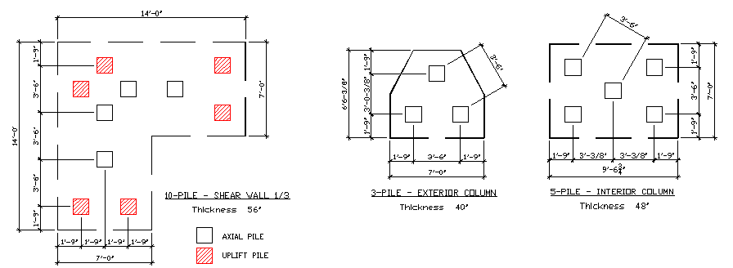
STRUCTURAL DEPTH- FOUNDATION
FOUNDATION MODIFICATIONS

Slide 18
ARCHITECTURAL FAÇADE STUDY-
Precast Wall Design

Slide 19
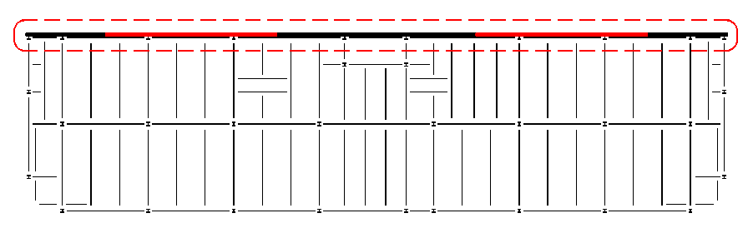
FAÇADE STUDY- GOALS
REPLACE REAR FAÇADE
OF BUILDING, PREVIOUSLY
MASONRY SHEAR WALLS
DETERMINE MOST APPROPRIATE WALL SYSTEM
  CMU Wall System
  Poured Concrete Wall System
  Precast Concrete Wall System
DESIGN WALL SYSTEM CONSIDERING ARCHITECTURAL ISSUES
  Fire Wall Rating – 2 Hour Required
  Moisture Penetration
  Aesthetics
  Cost/Construction

Slide 20
FAÇADE STUDY- SYSTEM COMPARISON
WALL SYSTEM | DESIGN FLEXIBILITY | FORMWORK REQUIRED | REQUIRED FIRE WALL THICKNESS | MOISTURE LEAK RESISTANCE
CMU | -- | -- | 8” | --
POURED CONCRETE | -- | X | 4” | X
PRECAST CONCRETE | X | -- | 4” | X

Slide 21
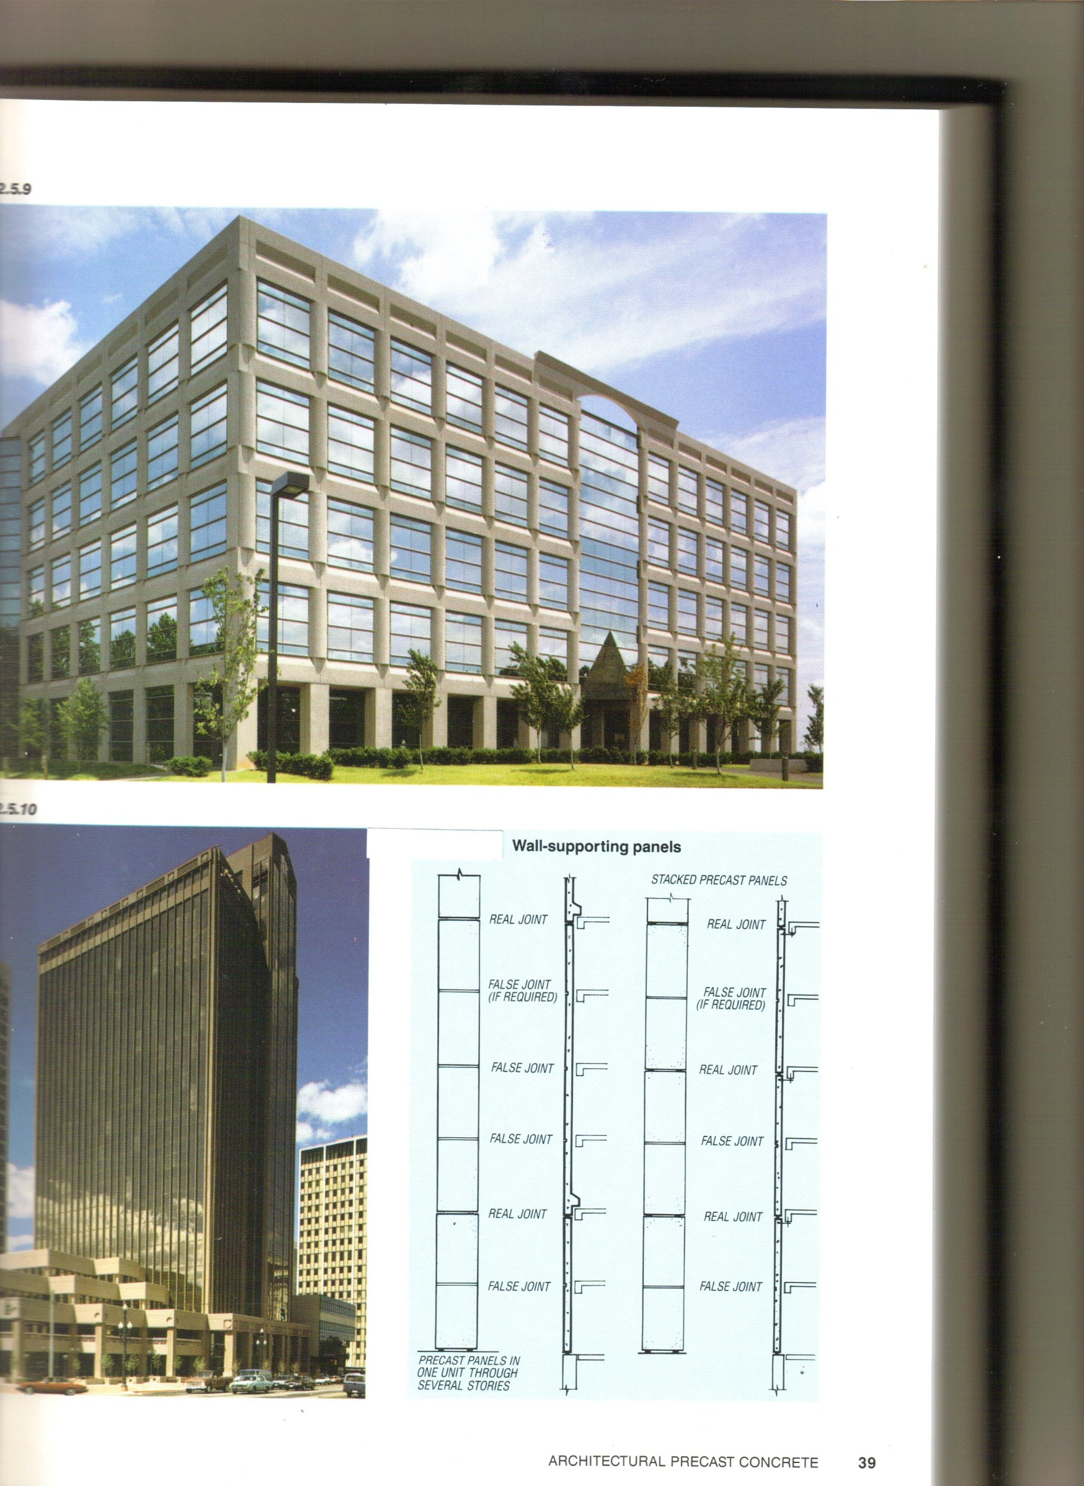
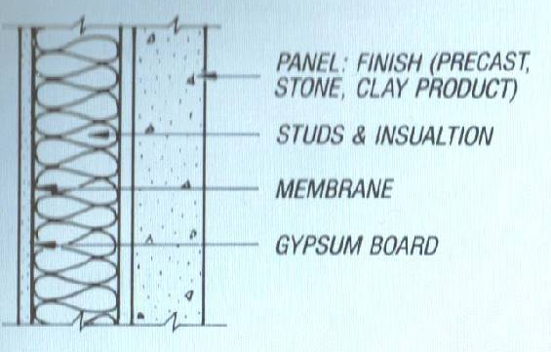
FAÇADE STUDY- PRECAST DESIGN
CONVENTIONAL WALL SYSTEM SELECTED
  Only 1 Wythe of precast required
  Simple manufacturing/ installation
STACKED PANEL SUPPORT SYSTEM SELECTED
  Panels bear on panels below
  Eliminate additional gravity load on slab
  Only transfer lateral loads to structure

Slide 22
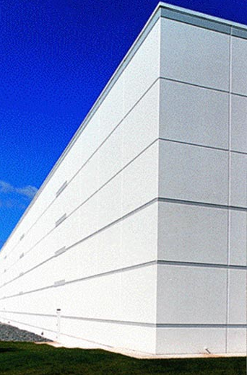
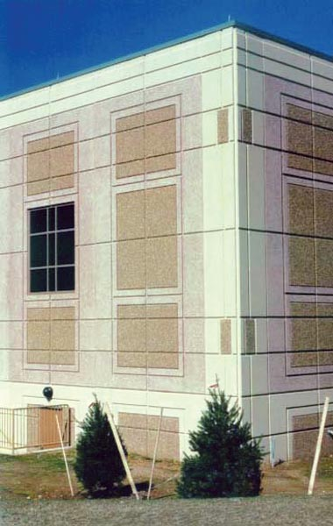
FAÇADE STUDY- PRECAST DESIGN
PANEL SELECETION
  Repetitive panel layout selected
  30’-8 1/8” x 13’-8” panel typical (1 Bay x 1 Story)
AESTHETIC CONSIDERATIONS
  Not high priority for this application
  Aesthetic enhancements can account for large percent of total cost
    Aggregate 5-20%
    Cement 4-8%

Slide 23
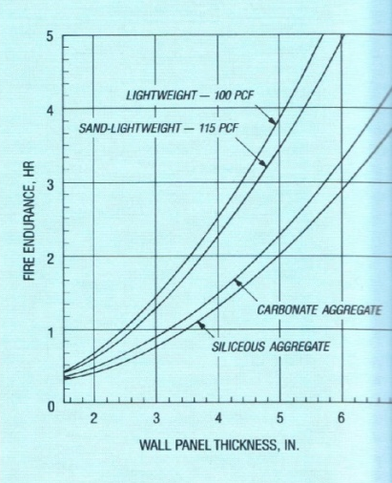
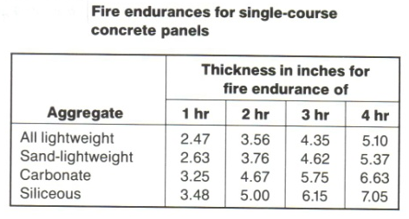
FAÇADE STUDY- PRECAST DESIGN
FIRE RESISTANCE
  Used to determine panel thickness
  Sand-Lightweight Concrete
  Original design called for façade to act as two-hour fire barrier
  3.76 ” 4” THICK PANEL

Slide 24
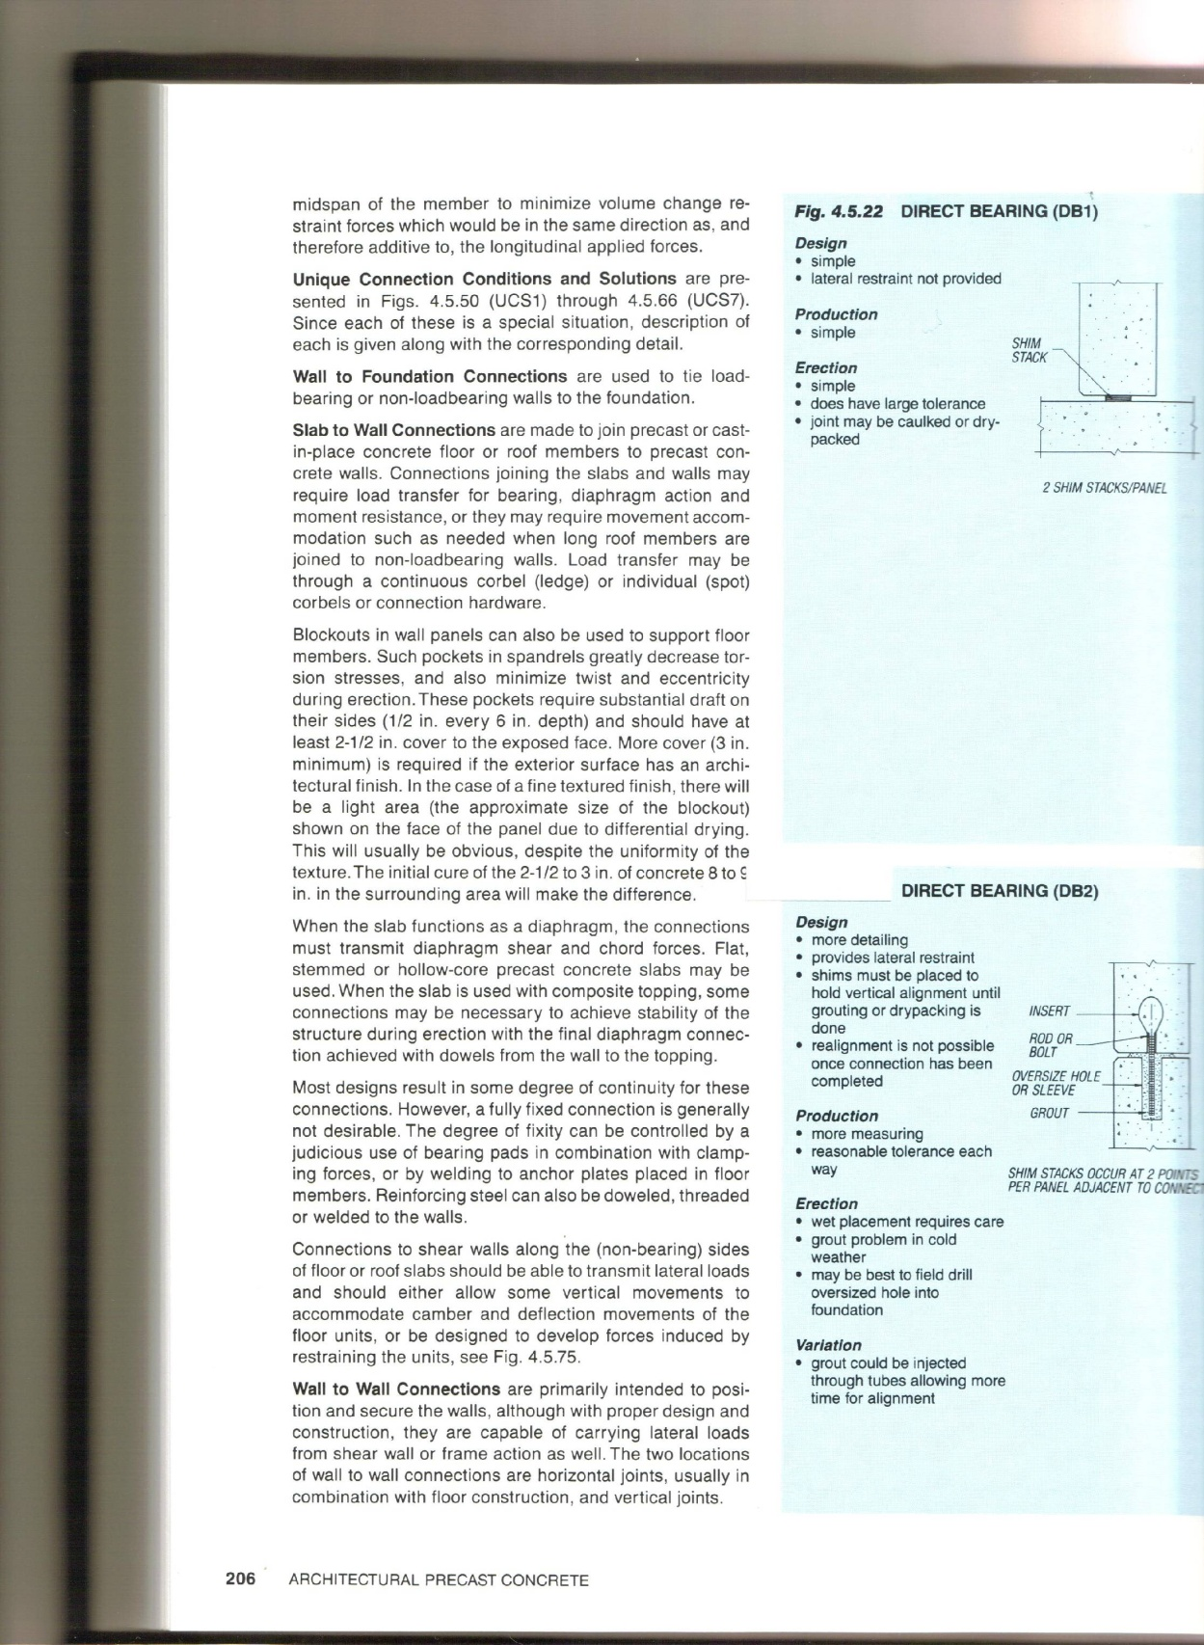
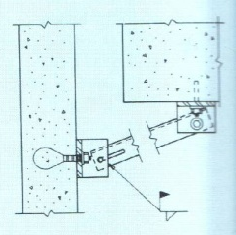
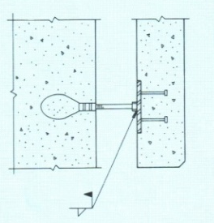
FAÇADE STUDY- PRECAST DESIGN
CONNECTIONS
TYPICAL PANEL
DIRECT BEARING CONNECTION
LATERAL TIE-BACK
CONNECTION
LATERAL TIE-BACK
CONNECTION @
SHEAR WALL

Slide 25
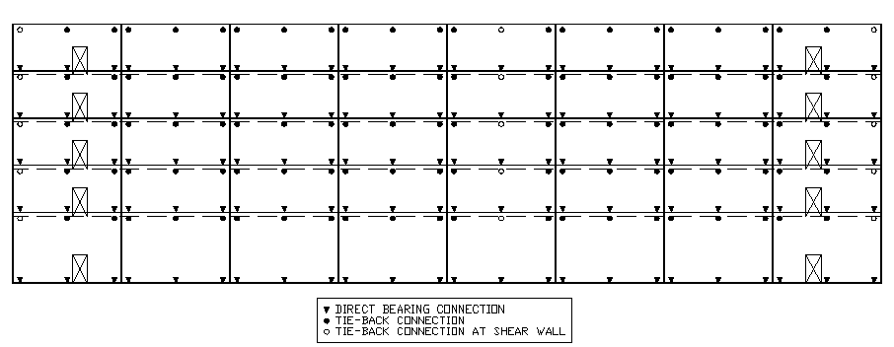
FAÇADE STUDY- PRECAST DESIGN
PANEL AND CONNECTION LAYOUT

Slide 26
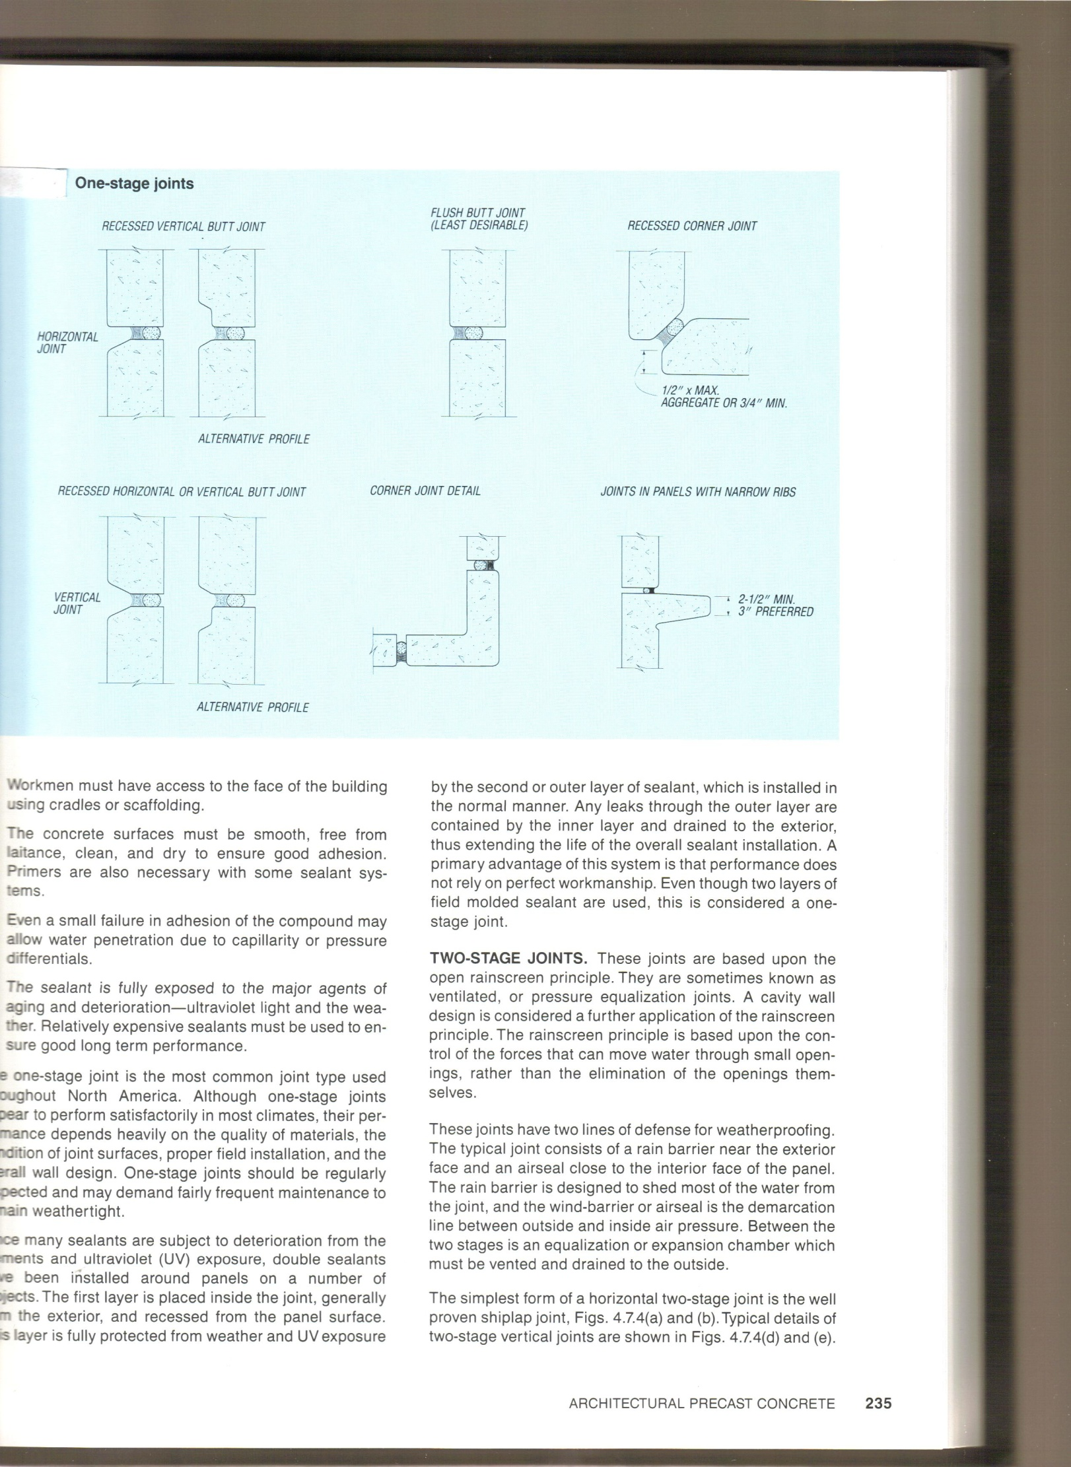
FAÇADE STUDY- PRECAST DESIGN
JOINT CALCULATION AND SEALANT SELECTION
  One-stage recessed joints selected
  Thermal expansion requires 1” wide joints
  Two-Component Polyurethane sealant selected
    25% Extensibility
    Very good weather resistance

Slide 27
CONSTRUCTION INVESTIGATION-
Cost, Schedule, and Site Layout

Slide 28
CONSTRUCTION INVESTIGATION- COST
COMPONENT | EXISTING STEEL STRUCTURE | REDESIGNED CONCRETE STRUCTURE
GRAVITY/LATERAL SYSTEM | W-Shape Steel Columns | Reinf. Concrete Columns
 | W-Shape Steel Beams | Reinf. Concrete Shear Walls
 | W-Shape Steel Braces | Concrete Shear Caps
 | Steel Studs
FLOOR SYSTEM | Steel Decking | Normal Weight Concrete
 | Lightweight Concrete | Post-Tensioning Cables
 | WWM Reinforcing
REAR FAÇADE | Reinforced 8” CMU Wall | Architectural Precast Wall
FOUNDATION MODIFICATION | N/A | Additional Piles

Slide 29
CONSTRUCTION INVESTIGATION- COST
COMPONENT | EXISTING STEEL STRUCTURE | REDESIGNED CONCRETE STRUCTURE
GRAVITY/LATERAL SYSTEM | Base | -204.32%
FLOOR SYSTEM | Base | +106.55%
REAR FAÇADE | Base | -33.50%
FOUNDATION MODIFICATION | Base | +$36,000
TOTAL COMPARABLE COST | Base | -22.50%

Slide 30
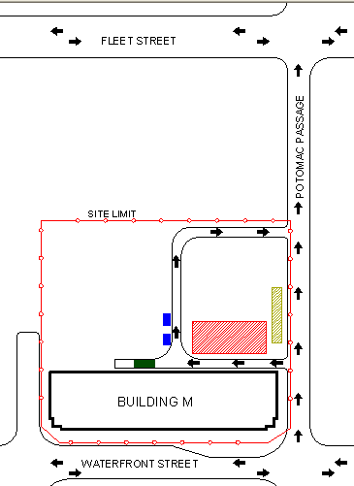
CONSTRUCTION INVESTIGATION- SITE LAYOUT
TEMPORARY ROAD
SITE TRAILERS
DUMPSTERS
PUMP TRUCK/
CRANE
STAGGING AREA

Slide 31
CONSTRUCTION INVESTIGATION- SCHEDULE
17 days total per floor X 5 floors @ 3 days overlap = 73 days
21 + 73 days = 94 total days or approximately 19 weeks
COMPONENT | STAGE | PROCEDURE | DURATION (DAYS/FL)
Detailing/ Shop Drawings | -- | Completion/ Approval | 21 (total)
Columns/ Shear Walls | 1 | Formwork/ Reinforcing / Pouring | 3
 | 2 | Curing/ Stripping of Formwork | 4
Slab | 1 | Formwork/ Reinforcing/ Pouring | 5
 | 2 | Curing | 3
 | 3 | Stressing Tendons/ Stripping of Formwork/ Re-shoring | 2

Slide 32

THESIS OBJECTIVES- CONCLUSION
STRUCTURAL DEPTH - achieve efficiency of the steel design using a concrete-based structure
ARCHITECTURAL FAÇADE - determine and design the most STUDY BREADTH efficient wall system for the rear façade
CONSTRUCTION INVESTIGATION- determine effects of the concrete BREADTH redesign in terms of cost, schedule, and site layout

Slide 33
QUESTIONS?

Slide 34
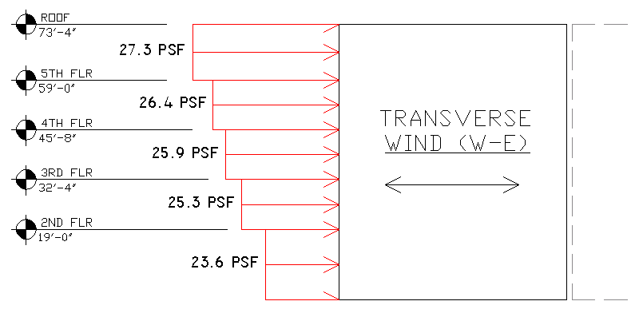
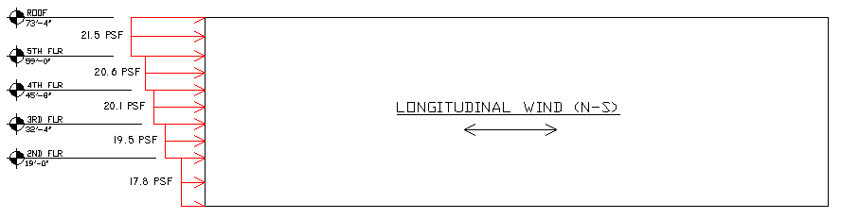
STRUCTURAL DEPTH- LATERAL SYSTEM
WIND LOADING
  Rigid structure, Exposure D, Basic Wind Speed = 90 mph

Slide 35
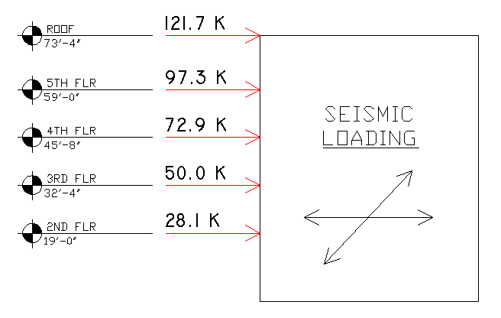
STRUCTURAL DEPTH- LATERAL SYSTEM
SEISMIC LOADING
  Site Class – D
  Seismic Design Category – B
  Importance Factor (I) – 1.0
  Seismic Resisting System – Ordinary Reinforced Concrete Shear Walls
  Response Modification Factor (R) – 4.0
  Deflection Amplification Factor (Cd) – 4.0
  Building Period – 0.6678 seconds
  Seismic Response Coefficient – 0.0378
  Seismic Weight – 9,762 Kips
  Design Base Shear – 369 Kips

